Slide 1
IBM EMPLOYEES ATTRITION ANALYTICS & PREDICTION
Author
SAJID ANWAR

Slide 2
Why HR Analytics?
Problem Statement
Human resource analytics (HR analytics) is an area in the field of analytics that refers to applying analytic processes to the human resource department of an organization in the hope of improving employee performance and therefore getting a better return on investment.
HR analytics does not just deal with gathering data on employee efficiency. Instead, it aims to provide insight into each process by gathering data and then using it to make relevant decisions about how to improve these processes.
To analyse and predict the attrition of the company’s valuable employees from the IBM Employee Attrition dataset containing information about the employees like age, monthly income, job level, performance rating, years at company etc.

Slide 3
BUSINESS PROBLEM
“Attrition in human resources refers to the gradual loss of employees over time. In general, relatively high attrition is problematic for companies. HR professionals often assume a leadership role in designing company compensation programs, work culture and motivation systems that help the organization retain top employees.”
Our role is to uncover the factors that lead to employee attrition through Exploratory Data Analysis, and explore them by using various classification models to predict if an employee is likely to quit. This could greatly increase the HR’s ability to intervene on time and remedy the situation to prevent attrition.
While this model can be routinely run to identify employees, who are most likely to quit, the key driver of success would be the human element of reaching out the employee, understanding the current situation of the employee and taking action to remedy controllable factors that can prevent attrition of the employee.

Slide 4




PROCESS FLOW
EDA
Base Model
Final Model
Business Insight
Exploratory Data Analysis
Logistic Regression
Random Forest
Suggestive Measure
Without ‘SMOTE’
With ‘SMOTE’, Feature Selection, Feature Engineering , Hyperparameter tuning, binning of Skewed Features
Our findings.
Key factors responsible for Employee Attrition
Univariate, Bivariate, Multivariate analysis, outlier detection and its treatment

Slide 5
VARIABLE CATEGORIZATION
DATASET INFORMATION:
Count of categorical features - 18
Count of numerical features – 19
BEHIND THE FEARURES HAVING NUMERICAL VALUES:
Some details of the column feature values represented as 1, 2, 3, 4, and 5.
FEATURE/VALUE | 1 | 2 | 3 | 4 | 5
EDUCATION | BELOW COLLEGE | COLLEGE | BACHELOR | MASTER | DOCTOR
ENVIROMENT SATISFACTION | LOW | MEDIUM | HIGH | VERY HIGH | -
JOB INVOLVEMENT | LOW | MEDIUM | HIGH | VERY HIGH | -
JOB SATISFACTION | LOW | MEDIUM | HIGH | VERY HIGH | -
PERFORMANCE RATING | LOW | MEDIUM | HIGH | VERY HIGH | -
RELATIONS SATISFACTION | LOW | MEDIUM | HIGH | VERY HIGH | -
WORKLIFEBALANCE | BAD | GOOD | BETTER | BEST | -

Slide 6
 | NAME | DESCRIPTION |  | NAME | DESCRIPTION
1 | AGE | NUMERICAL VALUE | 20 | MARITAL STATUS | (1=DIVORCED, 2=MARRIED, 3=SINGLE)
2 | ATTRITION | EMPLOYEE LEAVING THE COMPANY (0=NO, 1=YES) | 21 | MONTHLY INCOME | NUMERICAL VALUE - MONTHLY SALARY
3 | BUSINESS TRAVEL | (1=NO TRAVEL, 2=TRAVEL FREQUENTLY, 3=TRAVEL RARELY) | 22 | MONTHY RATE | NUMERICAL VALUE - MONTHY RATE
4 | DAILY RATE | NUMERICAL VALUE - SALARY LEVEL | 23 | NUMCOMPANIES WORKED | NUMERICAL VALUE - NO. OF COMPANIES WORKED AT
5 | DEPARTMENT | (1=HR, 2=R&D, 3=SALES) | 24 | OVERTIME | (1=NO, 2=YES)
6 | DISTANCE FROM HOME | NUMERICAL VALUE - THE DISTANCE FROM WORK TO HOME | 25 | PERCENT SALARY HIKE | NUMERICAL VALUE - PERCENTAGE INCREASE IN SALARY
7 | EDUCATION | NUMERICAL VALUE | 26 | PERFORMANCE RATING | NUMERICAL VALUE - ERFORMANCE RATING
8 | EDUCATION FIELD | (1=HR, 2=LIFE SCIENCES, 3=MARKETING, 4=MEDICAL SCIENCES, 5=OTHERS, 6= TEHCNICAL) | 27 | RELATIONSHIP SATISFACTION | NUMERICAL VALUE - RELATIONS SATISFACTION
9 | EMPLOYEE COUNT | NUMERICAL VALUE | 28 | STOCK OPTIONS LEVEL | NUMERICAL VALUE - STOCK OPTIONS
10 | EMPLOYEE NUMBER | NUMERICAL VALUE - EMPLOYEE ID | 29 | TOTAL WORKING YEARS | NUMERICAL VALUE - TOTAL YEARS WORKED
11 | ENVIROMENT SATISFACTION | NUMERICAL VALUE - SATISFACTION WITH THE ENVIROMENT | 30 | TRAINING TIMES LAST YEAR | NUMERICAL VALUE - HOURS SPENT TRAINING
12 | GENDER | (1=FEMALE, 2=MALE) | 31 | WORK LIFE BALANCE | NUMERICAL VALUE - TIME SPENT BEWTWEEN WORK AND OUTSIDE
13 | HOURLY RATE | NUMERICAL VALUE - HOURLY SALARY | 32 | YEARS AT COMPANY | NUMERICAL VALUE - TOTAL NUMBER OF YEARS AT THE COMPNAY
14 | JOB INVOLVEMENT | NUMERICAL VALUE - JOB INVOLVEMENT | 33 | YEARS IN CURRENT ROLE | NUMERICAL VALUE -YEARS IN CURRENT ROLE
15 | JOB LEVEL | NUMERICAL VALUE - LEVEL OF JOB | 34 | YEARS SINCE LAST PROMOTION | NUMERICAL VALUE - LAST PROMOTION
16 | JOB ROLE | (1=HC REP, 2=HR, 3=LAB TECHNICIAN, 4=MANAGER, 5= MD, 6= RD, 7= RESEARCH SCIENTIST, 8=SE, 9= SALES REPRESENTATIVE) | 35 | YEARS WITH CURRENT MANAGER | NUMERICAL VALUE – NUMBER OF YEARS
17 | JOB SATISFACTION | NUMERICAL VALUE - SATISFACTION WITH THE JOB | 36 | EMPLOYEE SOURCE | CATEGORICAL
18 | APPLICATION ID | NUMERIACL VALUE - EMPLOYEE ID | 37 | OVER18 | (1=YES, 2=NO)
19 | STANDARD HOURS | NUMERIACL VALUE – TOTAL WORKING HOURS

Slide 7
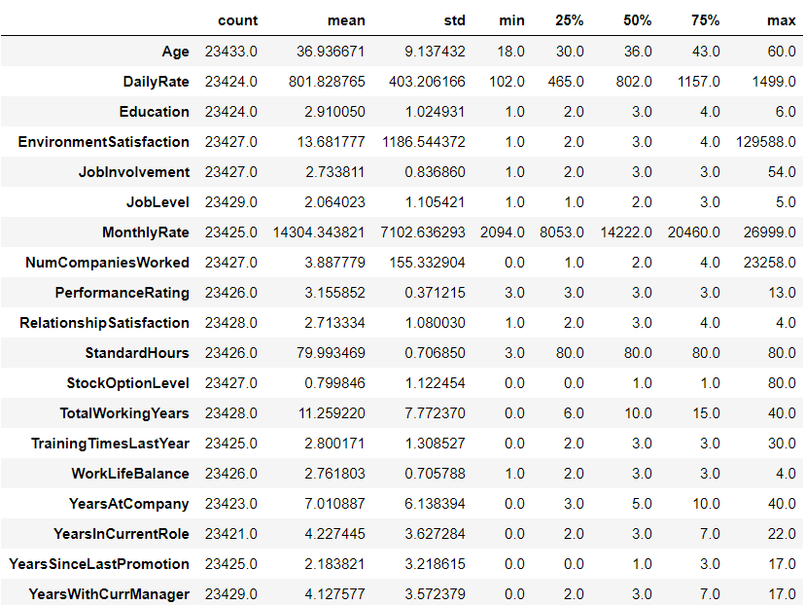
DESCRIPTIVE STATS (NUMERICAL COLUMNS)

Slide 8
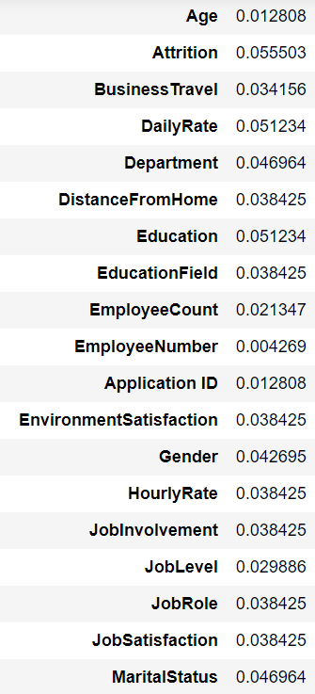
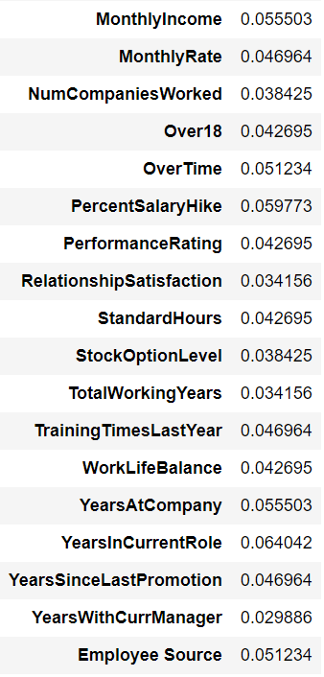
DATASET INFORMATION Count of duplicate columns= 28 Count & percentage of total missing values are 352 & 1.5% respectively. Feature-wise percentage of missing values are given in below snippets.

Slide 9

OUTLIERS
Upon doing EDA we came to know that the presence of outlier is due to the fact that in any organization there are multiple departments where in those departments, employees and managers salary will differ from position to position and experience won’t be similar throughout so we cannot remove these instead we will try to treat them, by discretizing them, creating appropriate bins or intervals.
This can help in spreading the values of a skewed variable across a set of bins with an equal number of observations.

Slide 10
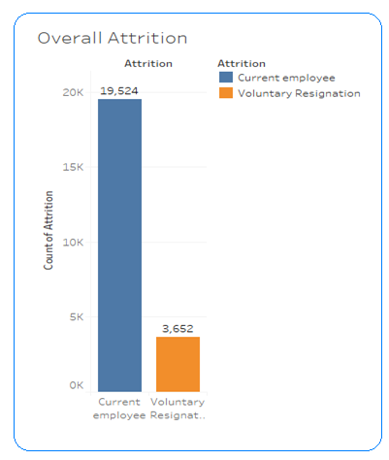


EXPLORATORY DATA ANALYSIS
IMBALANCE DATASET
CURRENT EMPLOYEE
(19524/23436)
VOLUNTARY
RESIGNATION
(3652/23436)
We have a imbalanced dataset with majority of observations being of one type ('No' which is '0' in the dataset) in our case. We have about 84.24% of observations having 'No' and only 15.76 % of 'Yes' and hence this is an imbalanced dataset.
use an oversampling technique known as the SMOTE(Synthetic Minority Oversampling Technique) which randomly creates some 'Synthetic' instances of the minority class so that the net observations of both the class get balanced out .

Slide 11
FEATURE CATEGORIZATION
Personal Aspect
Age
Marital Status
Distance From Home
Gender
Credential Based
Department
Education Field
No of Companies Worked
Total Working Years
Job Role
Professional Benefits
Monthly Income
Percent Salary Hike
Professional Obligations
Over Time
Business Travel

Slide 12
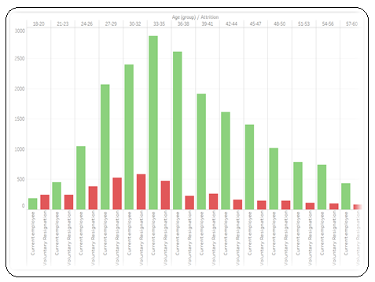
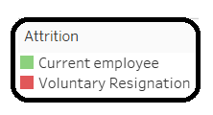
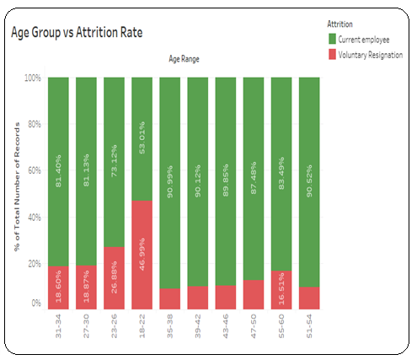
PERSONAL ASPECT: AGE VS ATTRITION
Younger employees are mostly contributing towards attrition, employees having age greater than 35 are found somewhat stable in their job.

Slide 13
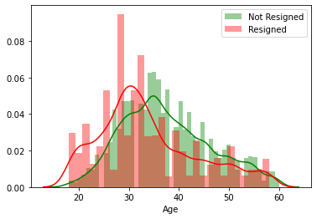
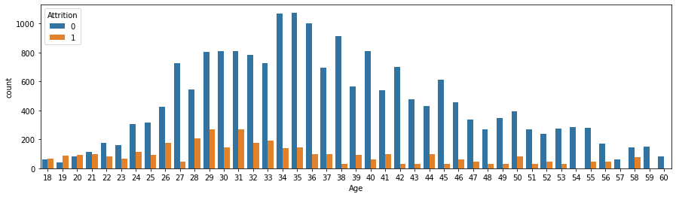
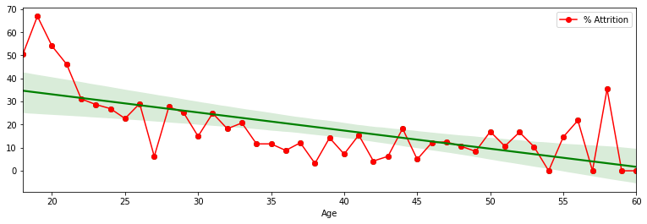
AGE
From distribution plot, age distribution for current employees & resigned employees are more or less overlapping and right-skewed.
From count plot we can observe that attrition percentage is high for starting career level may be because of more opportunity outside at this job level and ending time of career level may be because of retirement or settlement.
From regression plot we can see that as age of employees is increasing, attrition rate is decreasing.
Inverse correlation exists between attrition and age : -0.1524

Slide 14
GENDER AND ATTRITION
THE ATTRITION PERCENTAGE IN BOTH MALE AND FEMALE GENDER IS ALMOST SIMILAR BUT ATTRITION IN MALE IS HIGHER BY 0.9% THAN IN FEMALE
16.1%
15.2%
84% Current Employee
MALE
85%
Current Employee
FEMALE
TOTAL EMPLOYEE:13,900
CURRENT EMPLOYEE:11,661
EMPLOYEE LEFT:2,239
TOTAL EMPLOYEE:9,276
CURRENT EMPLOYEE:7,863
EMPLOYEE LEFT:1,413

Slide 15
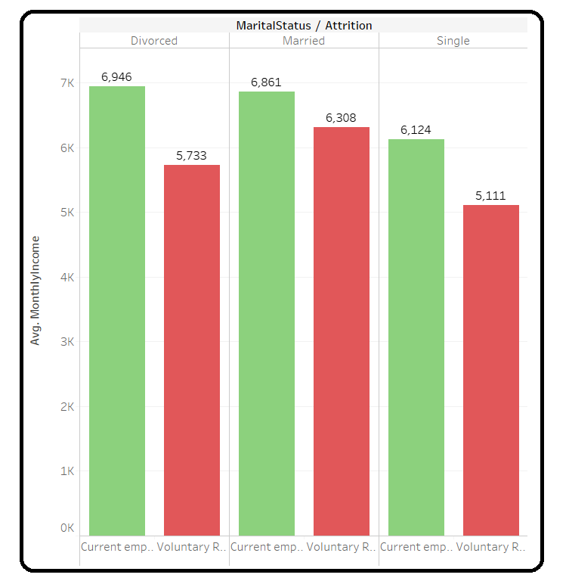
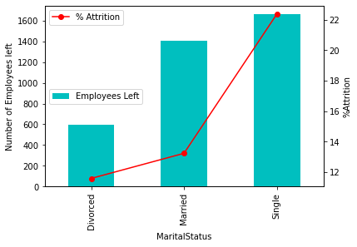
Marital Status Vs Attrition
1. Attrition rate is highest among single employees.
2. It is observed that employees who are married are having more attrition even when their average salary is greater than Singles and Divorced. Maybe due to family responsibilities they need more income, so HR Team should monitor married employees

Slide 16
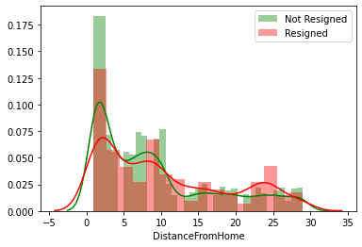
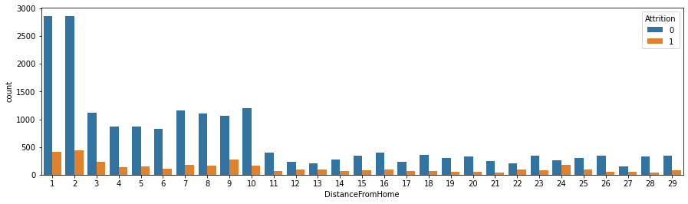
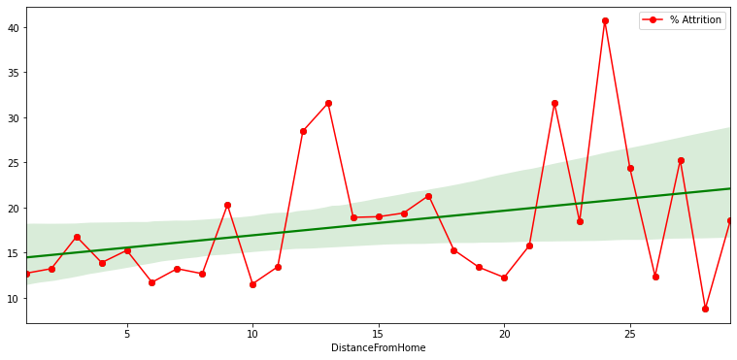
DISTANCE FROM HOME VS ATTRITION
From distribution plot, distance from home distribution for current employees & resigned employees are more or less overlapping and right-skewed.
From count plot we can observe that attrition percentage is high for those who are travelling from larger distances.
From regression plot we can see that as distance from home is increasing, attrition rate is increasing.
Positive correlation exists between attrition and distance from home : +0.0705

Slide 17
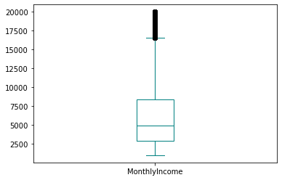
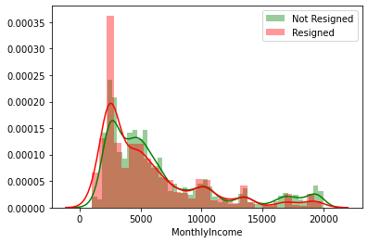
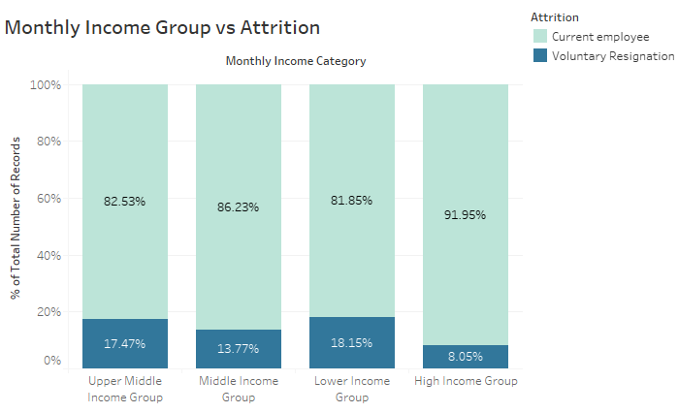
PROFESSIONAL BENEFITS
Monthly Income
From distribution plot, Monthly Income distribution for current employees & resigned employees are more or less overlapping and right-skewed.
From box plot, we found out there are 1797 outliers, which is 7.74%. So we cant remove the outliers due to information loss.
We can see that from bar plot that, attrition rate is highest among Lower Income Group.

Slide 18
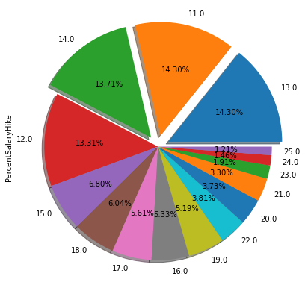
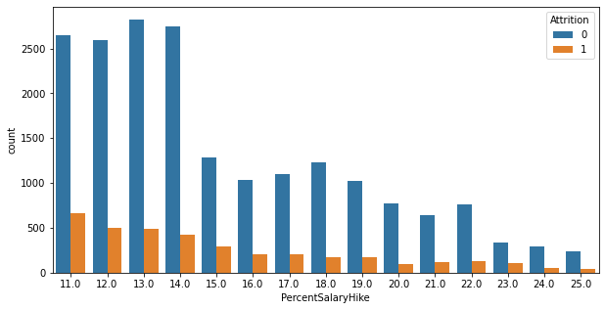
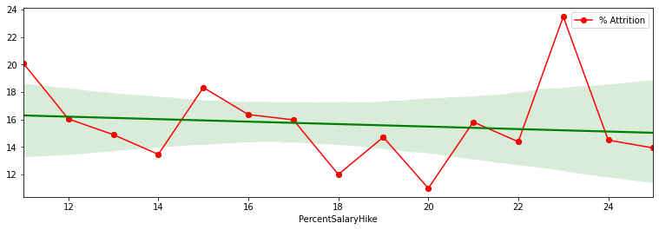
Percent Salary Hike
From pie plot, Most of the employees getting salary hikes between 11 & 14 both inclusive.
From count plot we observe that as percent salary hike increases, count of resigned employees decreases.
From regression plot we can see that as the percent salary hike is increasing attrition rate is decreasing.

Slide 19
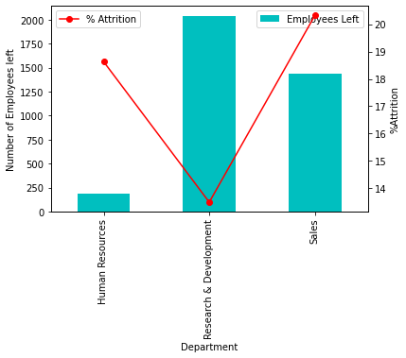
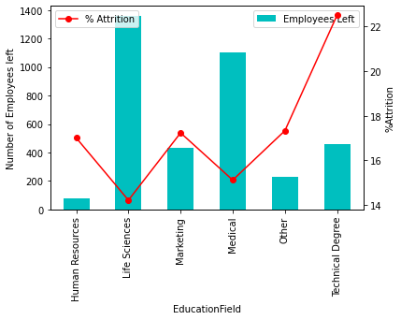
CREDENTIAL BASED
Department
R&D department has highest number of attrition but attrition rate is highest in Sales Department.
Life-Sciences education field has highest number of attrition but attrition rate is highest for Technical Degree.
Education Field

Slide 20
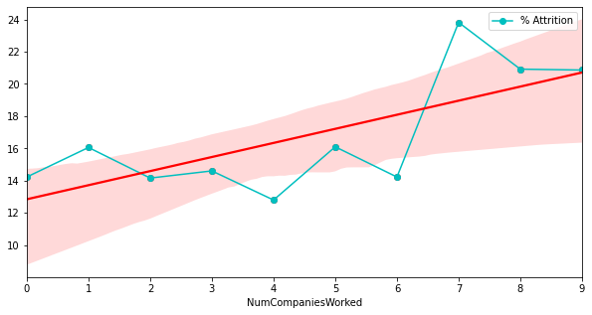
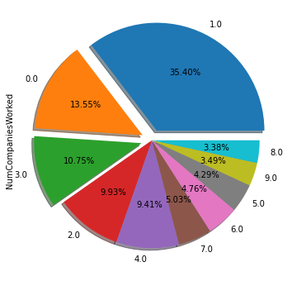
NUMBER OF COMPANIES WORKED
From pie plot, Almost 50% of the employees are previously worked in zero and one company.
From regression plot we can see that as the previous worked companies are increasing attrition rate is also increasing.

Slide 21
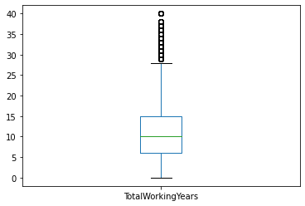
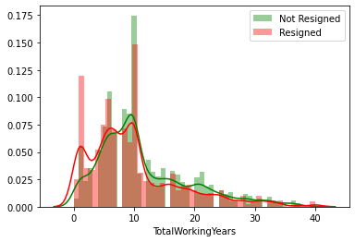
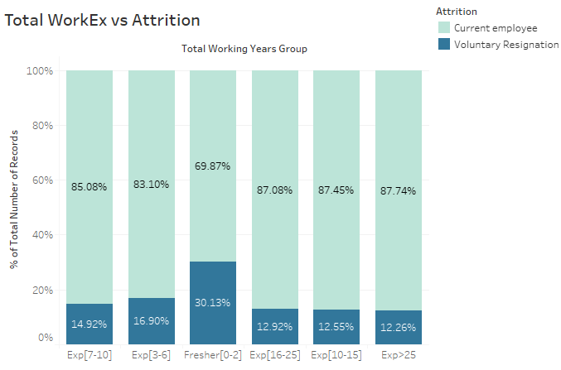
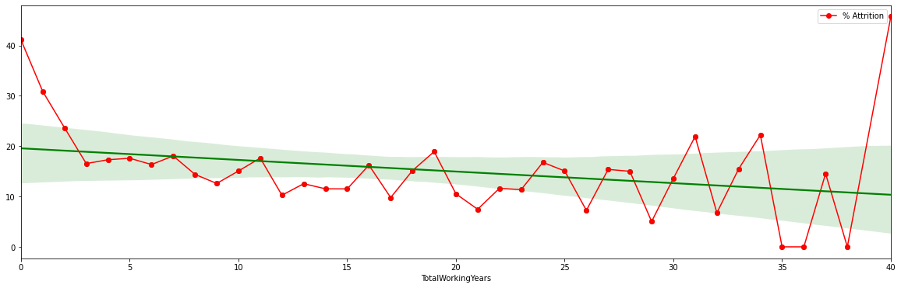
Total Working Years
From box plot, there are 988 outliers.
From distribution plot, we observe that current employees distribution and resigned employees distribution are overlapping.
From bar plot we can see that attrition rate is highest among employees having less than equal to 2 years of experience.
From regression plot, as experience is increasing attrition rate is decreasing.

Slide 22
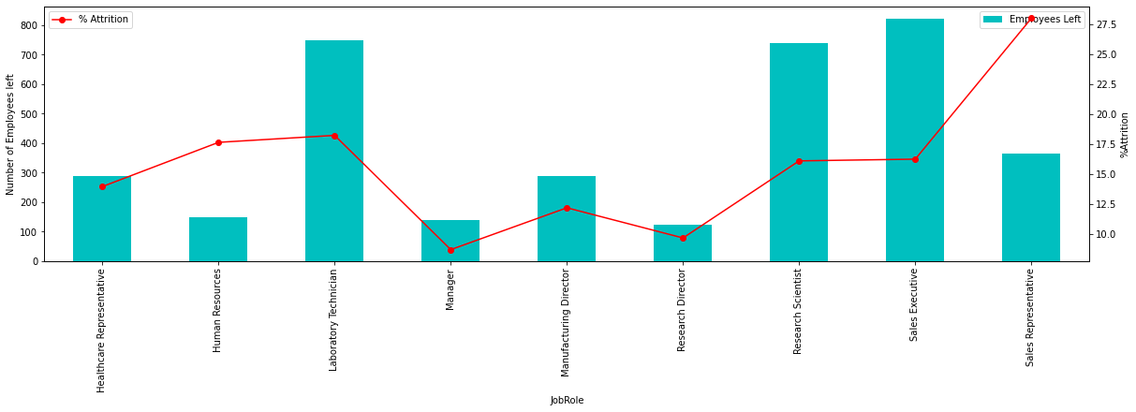
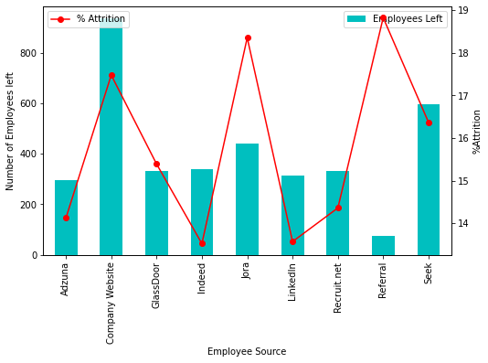
JOB ROLE
Sales Representatives have highest level of attrition rate but Sales Executives left the company most.
Referral employees has highest attrition rate. Employees recruited from LinkedIn & Indeed have seen lowest attrition rate.
Employee Source

Slide 23
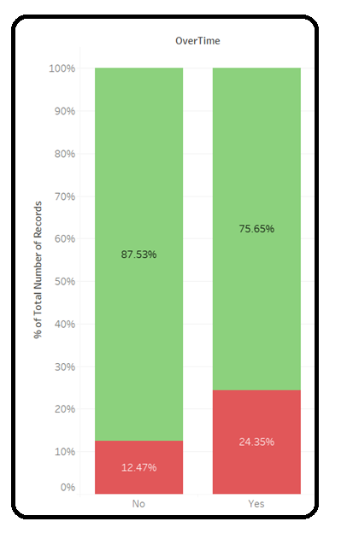
PROFESSIONAL OBLIGATIONS
OVERTIME VS ATTRITION
Overtime is a key feature which is responsible for attrition. Employees who are doing overtime are having approximately double attrition rate.
HR Team should consult with those employees whose working hours is higher.

Slide 24
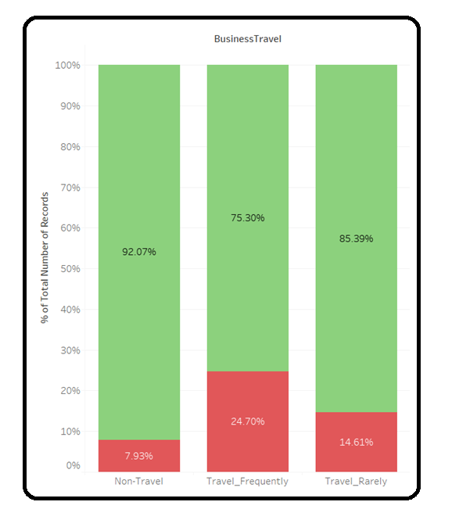
BUSINESS TRAVEL VS ATTRITION
Employees who are doing business travel for office work is having high attrition rate in comparison to employees who are non business travellers.
Thus HR Team should check for the travel allowances and other factors related to ease of the employees while travelling

Slide 25
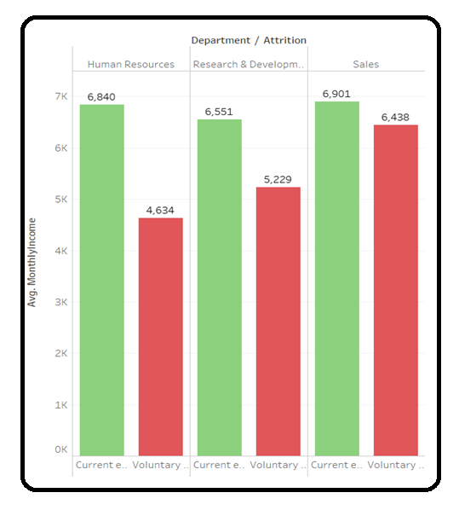
DEPARTMENT VS ATTRITION
Average monthly incomes of employees in each department are nearly same, but Sales department has the maximum number of attritions, which shows that the employees in Sales Department is not satisfied with their monthly income.

Slide 26
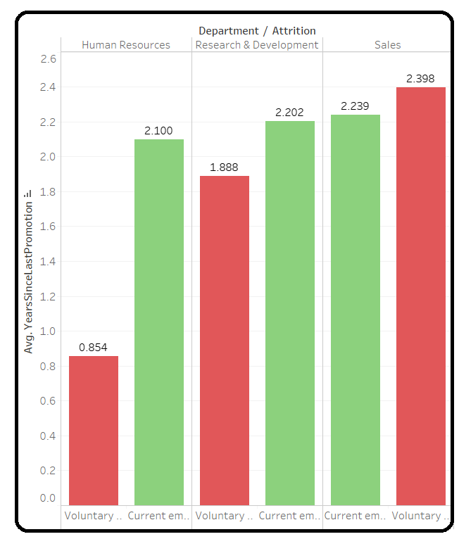
DEPARTMENT VS ATTRITION
Employees in sales department are having a very high rate of attrition if they are not promoted under the span of almost 2 years. So, HR team should do proper counseling of those employees.

Slide 27
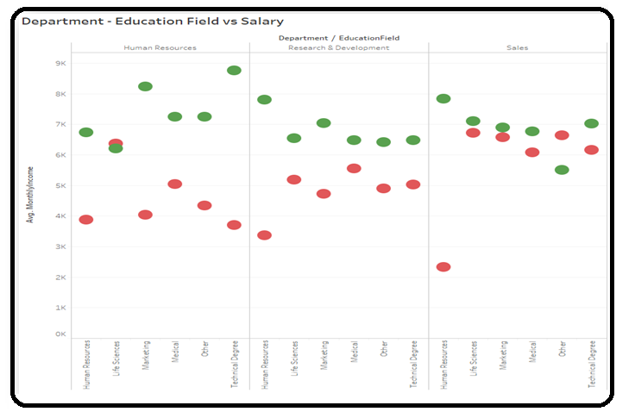
DEPARTMENT - EDUCATION FIELD WISE SALARY:
In each department and for each education field, whose average monthly income is lower those employees attrition rate is higher in all department .

Slide 28
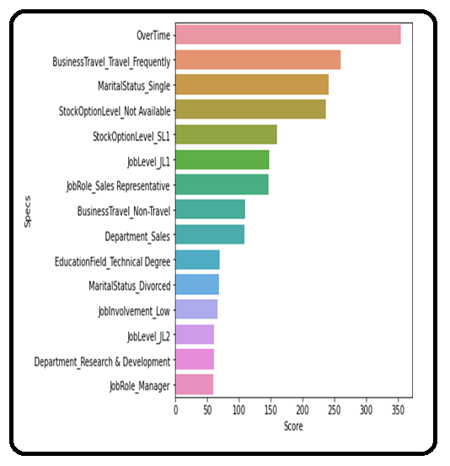
IMPORTANT FEATURES SELECTION USING STATISTICAL METHODS.
Dependent Feature : Categorical , Independent Features : Categorical
We have performed Chi-Square statistical test as both the dependent and independent features are categorical for finding out the top 15 important features that needs to be taken care of before model building. From bar plot we can see that Overtime is most significant feature for determining attrition rate followed by Business Travel.

Slide 29
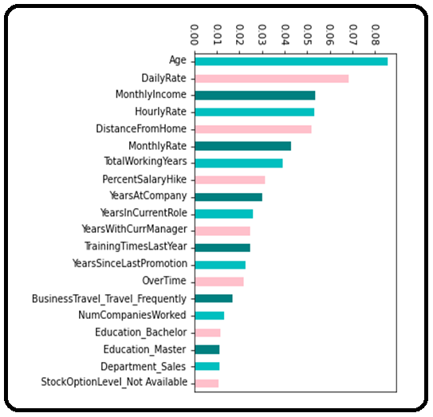
IMPORTANT FEATURES SELECTION USING RANDOM FOREST MACHINE LEARNING ALGORITHM.
Monetary related features like Daily Rate, Monthly Income, Hourly Rate, Percent Salary Hike, Stock-option level are significant features for predicting the attrition of employees. Also, Age plays important role in determining the attrition of employees.

Slide 30
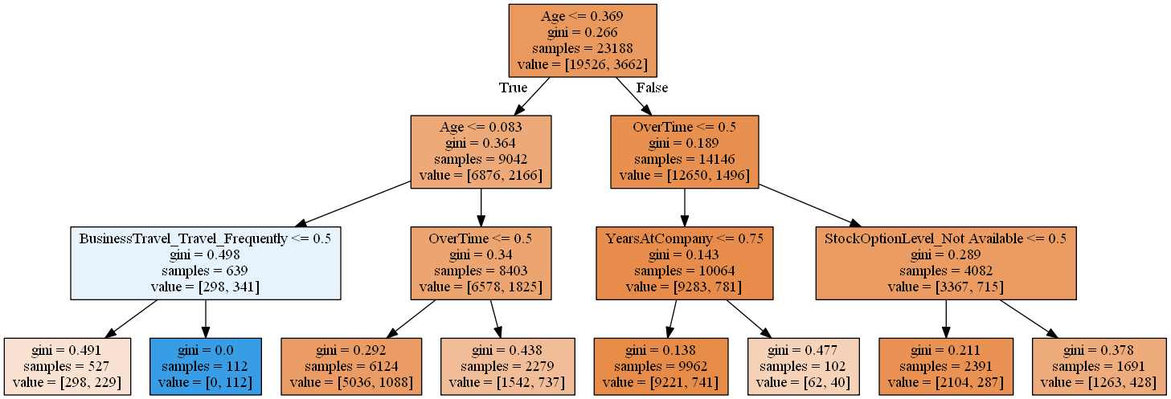
Exploring Decision-Tree for Feature Importance:
We can also observe from above decision tree that Age, Overtime, Business Travel, Stock option level, Years at Company are giving highest purity level to distinguish between current employee and resigned employee.

Slide 31
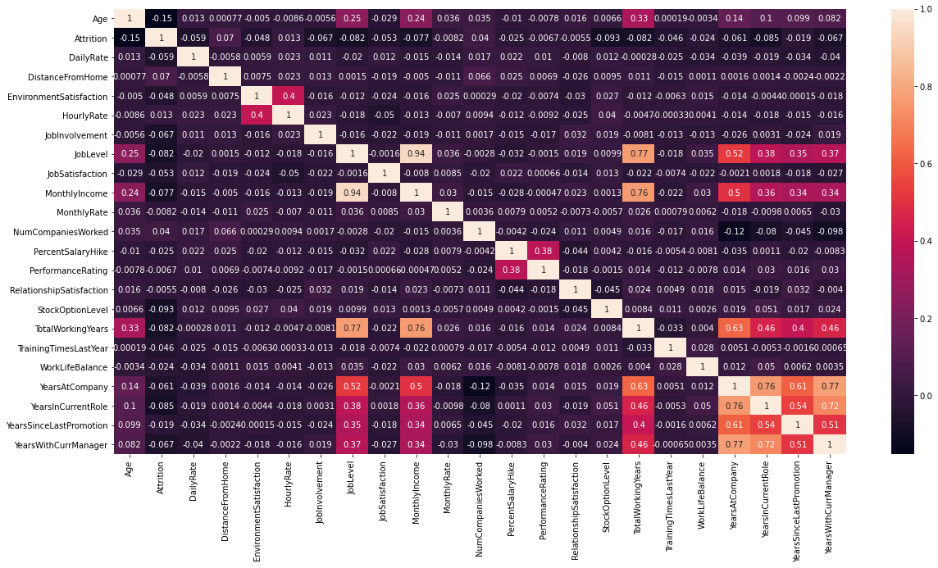
IMPORTANT FEATURES VISUALIZATION USING CORRELATION HEATMAP:
From the correlation plot, we can see that quite a lot of our columns seem to be poorly correlated with one another. Generally when making a predictive model, it would be preferable to train a model with features that are not too correlated with one another so that we do not need to deal with redundant features.

Slide 32
IMPORTANT FEATURES THAT NEEDS TO BE TAKEN CARE OF BEFORE MODEL BUILDING.
AGE
OVER TIME
BUSINESS TRAVEL
YEARS AT COMPANY
MONTHLY INCOME
DAILY RATE
DEPARTMENT
MARITAL STATUS
09. JOB LEVEL
10. JOB ROLE
11. STOCK OPTION LEVEL
12. PERCENT SALARY HIKE
13. YEARS AT CURRENT ROLE
14. YEARS WITH CURRENT MANAGER
15. TOTAL WORKING YEARS
EDUCATION

Slide 33
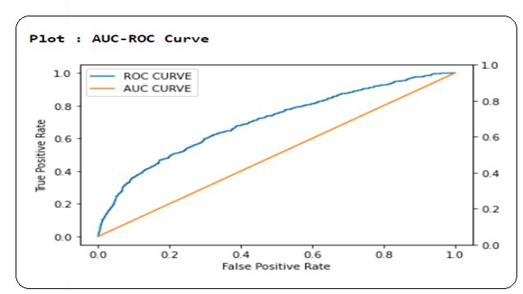
BASE MODEL-LOGISTIC REGRESSION
It is a classification algorithm, that is used where the response variable is categorical. The idea of Logistic Regression is to find a relationship between features and probability of particular outcome.
LOGISTIC REGRESSION
TEST | PRECISION | RECALL | F1-SCORE
0 | 0.91 | 0.66 | 0.76
1 | 0.27 | 0.65 | 0.38
ACCURACY |  |  | 0.66
MACRO AVG | 0.59 | 0.66 | 0.57
WEIGHTED AVG | 0.81 | 0.66 | 0.70
BASE MODEL
WE USED LOGISTIC REGRESSION AS BASE MODEL,WITHOUT APPLYING ‘SMOTE’
Accuracy of Base Model is 66.00%

Slide 34
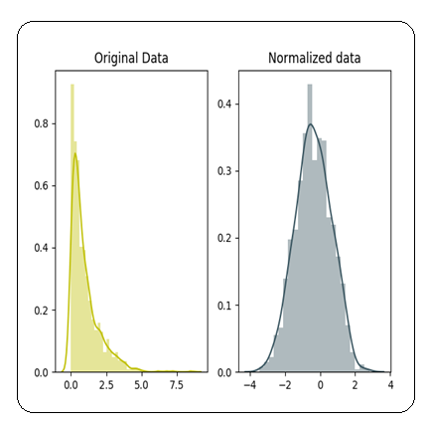
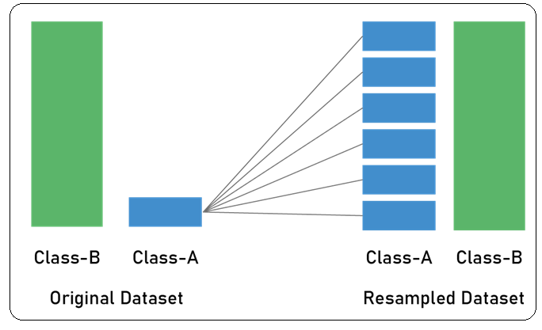
STANDARD SCALING THE DATASET:
Original Data = df
#Create scaler:
scaler = StandardScaler()
#Fit:
fit=scaler.fit(df)
#Transform:
Normalized_data = fit.transform(df)
SMOTE:
smote = SMOTE('minority')
X_sm, y_sm = smote.fit_sample(X_train,y_train)
More Data points are added in the minority class
using Synthetic Minority Over Sampling Technique
(SMOTE)

Slide 35
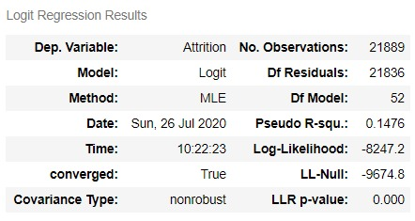
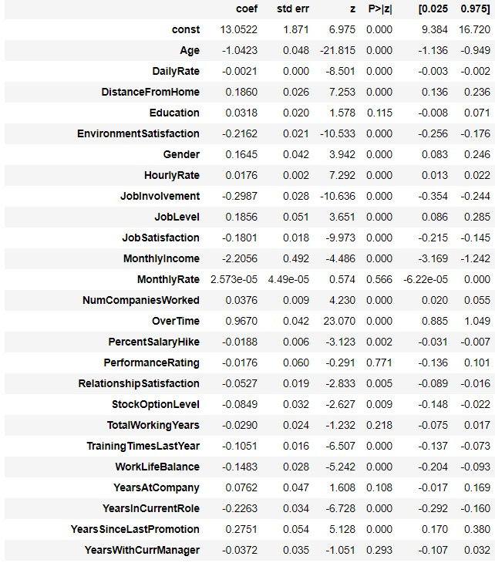
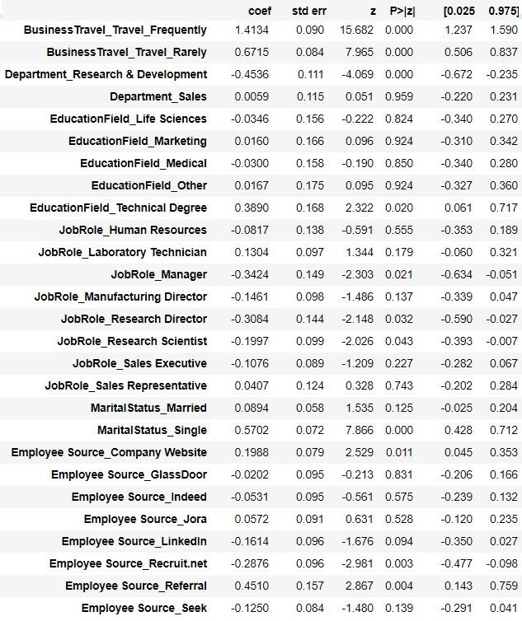
STATISTICAL REPORT:
Features like: :‘Education’,’MonthlyRate’,’PerformanceRating’,’TotalWorkingYears’, ’Years With Current Manager’ & some departments as well as education fields are Statistically insignificant as their p value is greater than 0.05.

Slide 36
RANDOM FOREST CLASSIFIER
Random Forest classifier after applying ‘SMOTE’ and feature Engineering.
Random forest classifier creates a set of decision trees from randomly selected subset of training set. It then aggregates the votes from different decision trees to decide the final class of the test object
Test Accuracy
AUC Score
84.45 %
76.72%
1
2
Confusion Matrix Train:
Confusion Matrix
Test:
[5501 9 ]
[985 72 ]
[12831 15 ]
[2281 195 ]
3
4

Slide 37
GRIDSEARCHCV WITH HYPER PARAMETER TUNING
Hyper parameter tuning has improved upon our accuracy score further to some extent.
Grid search works by trying every possible combination of parameters you want to try in your model. Those parameters are each tried in a series of cross-validation passes. This technique has been in vogue for the past several years as a way to tune your models.
Test Accuracy 93.58%
Confusion Matrix Train:
[ 12841 5]
[ 654 1822]
With
Hyper parameter Tuning
01
03
02
04
AUC SCORE
98.74%
Confusion Matrix
Test
[ 5502 8 ]
[ 413 644 ]

Slide 38
RANDOMIZEDSEARCHCV WITH HYPER PARAMETER TUNING
Random Search would be advised to use over Grid Search when the searching space is high meaning that there are more than 3 dimensions as Random Search is able to explore a wider hyper parameter space. When there are many parameters, Random Search could be preferred as too many parameters will increase time complexity for Grid Search. However, though Grid Search can be very computationally expensive, as an exhaustive search, it’s useful for looking through all the combinations of specified hyper parameters.
RandomizedSearchCV has decreased our accuracy as compared to GridSearchCV
Test Accuracy 89.91%
Confusion Matrix Train:
[ 12831 15]
[1336 1140]
With
Hyper parameter Tuning
01
03
02
04
Confusion Matrix
Test
[ 5501 9 ]
[ 653 404 ]
AUC score
94.47%

Slide 39
MODEL’S PERFORMANCE MATRIX
MODEL | ACCURACY SCORE TRAIN% | ACCURACY SCORE TEST % | APPROACH | REMARKS
Base Model Logistic Regression | 66.03% | 65.66% | Simple base model without optimum feature selection, unscaled and imbalanced data | Model performance is low
Scaled & Balanced Model Random Forest Classifier | 85.25% | 84.52% | Normalized using Standard Scalar and balanced using SMOTE, feature selection using Statistical test and model’s feature importance. | Model performance is satisfactory
Hyper tuned Model- Random Forest Classifier- GridSearchCV | 95.69 | 93.58 | Parameters tuned using GridSearchCV | Good model
Hyper tuned Model- Random Forest Classifier- RandomizedSearchCV | 97.12 | 89.99 | Parameters tuned using RandomizedSearchCV | Slightly over fit model

Slide 40
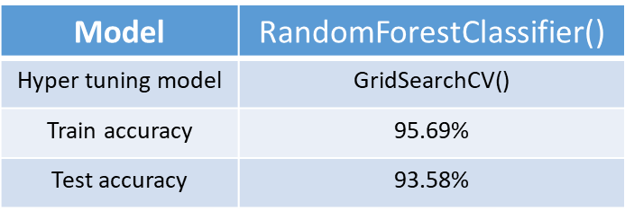
FINAL MODEL:
FINAL INFERENCE
The final model is a decent model which is neither under fit nor over fit and can be used to run a segmentation on employees, to develop certain “at risk” categories of employees. This could generate new insights for the business on what drives attrition, insights that cannot be generated by merely informational interviews with employees.

Slide 41
WHAT CAN BE DONE?
Following are some measures that can be taken in order to reduce Attrition.
OVER TIME: Employees working overtime are likely to resign, the organization should look into the matter what makes them to do overtime, is it the workload , or employees are not qualified enough to complete the task on time, . Our recommendation will be to understand the reasons behind overtime, and take appropriate measures to reduce the factors responsible for attrition.
TRAVELING: Employees travelling frequently are leaving the organization at a higher rate ,
The company should question what makes traveling a burden on their employees. If necessary , The company may use some extra incentives to motivate their employees who are supposed to travel more frequently.
PROMOTION: With an increase in year’s since last promotion, the attrition is also increasing, so the company, should communicate their expectations from the employees , and explain them how and when they will get promoted , if necessary they should revise their Promotion Policy.
MONTHLY INCOME: It is observed that the monthly income, is contributing more towards attrition and majority who got a salary hike of 11-14% have higher attrition rate , in such case increasing Employees Salary and thereby encouraging them to invest in companies stocks will help increase the employees job satisfaction level , and investing in stocks will urge them to perform better, and thus will help them to get promoted faster and will eventually decrease the Attrition.
$
$

Slide 42
T H A N K Y O U

